Slide 1
Semantic parsing: converting natural language questions into sql Presented by: Christopher Buss sanad saha

Slide 2
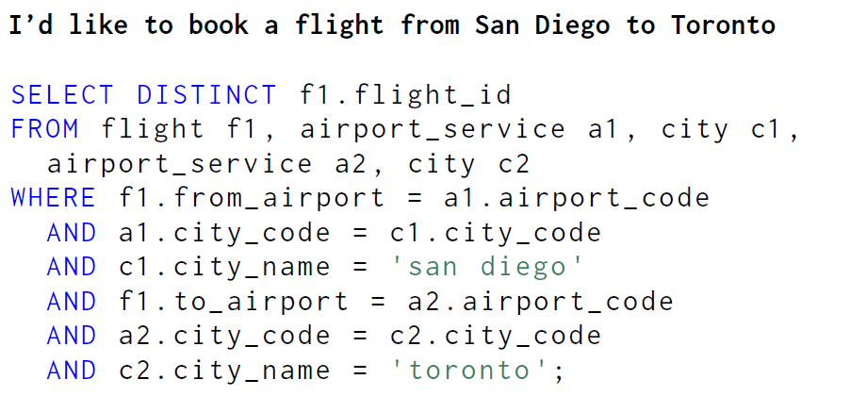
Problem Description
User doesn’t know SQL
User has no idea on the Schema of the Database
1

Slide 3
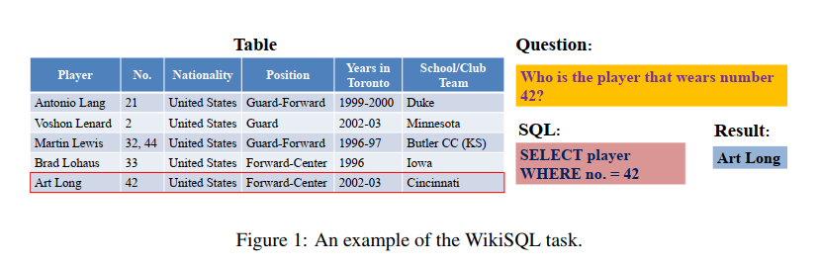
Our Goal
User doesn’t know SQL
User has no idea on the Schema of the Database
2

Slide 4
Related works
Significant number of research works in past 3 years. Since the release of WikiSQL Dataset
Presenting the ones we took inspiration from:
Seq2SQL (Zhong 2017)
Using LSTMs with Reinforcement Learning
SQLNet (XU 2017)
Using Seq2SQL without Reinforcement Learning
Introduces Sequence to Sequence modelling
And Column Attention
SQLova (Hwang 2019)
Used SQLNet as baseline and uses Google BERT for embedding
3

Slide 5
The wikisql Dataset
Pioneered the use of Deep Learning in this problem region.
80654 hand-annotated examples of questions and SQL queries distributed across 24241 tables from Wikipedia
Doesn’t take joins into account
There is a leaderboard which contains different papers citing their accuracies.
4

Slide 6
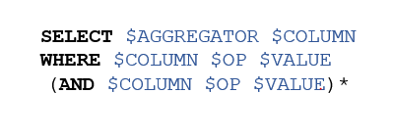
BUILDING THE MODEL
Heavily reliant on the WikiSQL dataset
Used the following Sketch for generating SQL.
From (table_id) is already supplied
5

Slide 7
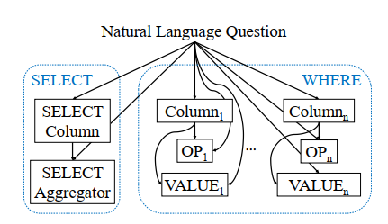
BUILDING THE MODEL
Using 3 Separate bi-LSTMs to predict
Which column to Select
Which Aggregator was used (eg. SUM, MAX, MIN etc.)
Where Conditions
Each LSTM had 100 hidden Units and the parameters were not shared among them
6

Slide 8
Embeddings for the model
We used GloVe [Stanford CoreNLP Tokenizer] to embed the Natural Language Questions and fed them to the LSTMs
We selected the Wiki2014 Corpus [Which had 6 Billion Tokens, 300 Dimensions]
We also tried out Current State of the art Google BERT for embedding the Natural Languages and fed them to the LSTMs
7

Slide 9
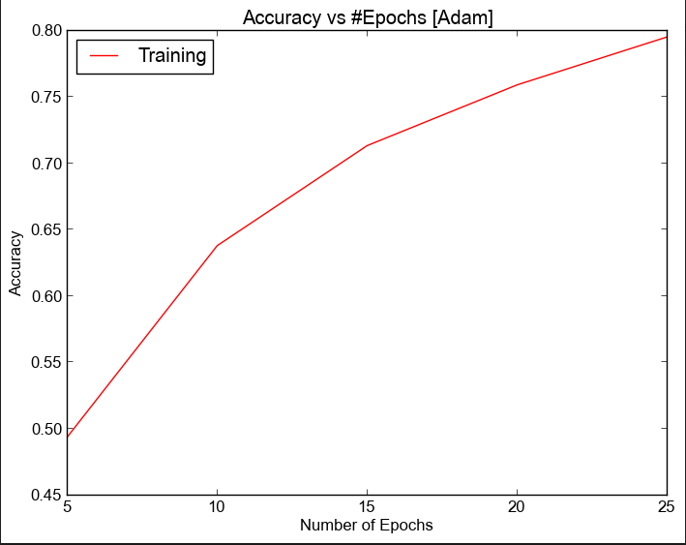
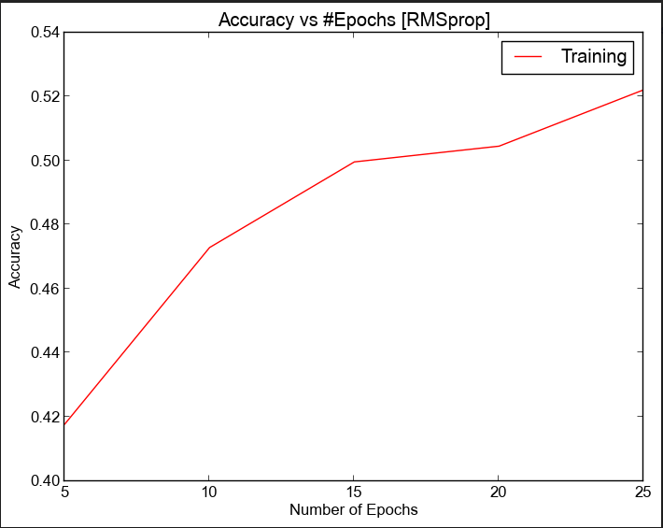
Changing the optimizer
We tested with both ADAM and RMSProp Optimizer
ADAM performed significantly better than other optimizers.
We also tried Stochastic Gradient Descent Optimizer which performed extremely poorly on predicting the ‘Where’ conditions.
8

Slide 10
Results Breakdown
After training for 25 epochs (6 hours) we reached 80%(ADAM) of training accuracy and saved the parameters.
Used our saved model on the Test dataset and gained 62% accuracy.
It’s possible to attain far better accuracy as reported in the paper which reached 83% testing accuracy after 200 epochs.
The main reason for low accuracy is incorrect prediction of the ‘Where’ clause.
After 25 epochs we got over 91% column accuracy, 87% aggregator accuracy and 64% ‘Where’ clause accuracy.
9

Slide 11
Future works
Predicting the table where Data is.
In this project table_ids’ were supplied with the Natural Language Questions
In reality: user might not provide any context to the Table.
Building model for Complex queries.
WikiSQL dataset had simple questions which we were able to sketch with a single template.
In reality questions can lead to join of different type on multiple number of tables.
Introducing new sketches [and adding more LSTMs] to predict them is not a viable solution.
Large Dataset of that type is also not available.
10

